Slide 1


Full Stack Development 30 Days Challenge
Git, GitHub and Version Control |Deployment
Day 17/30

Slide 2
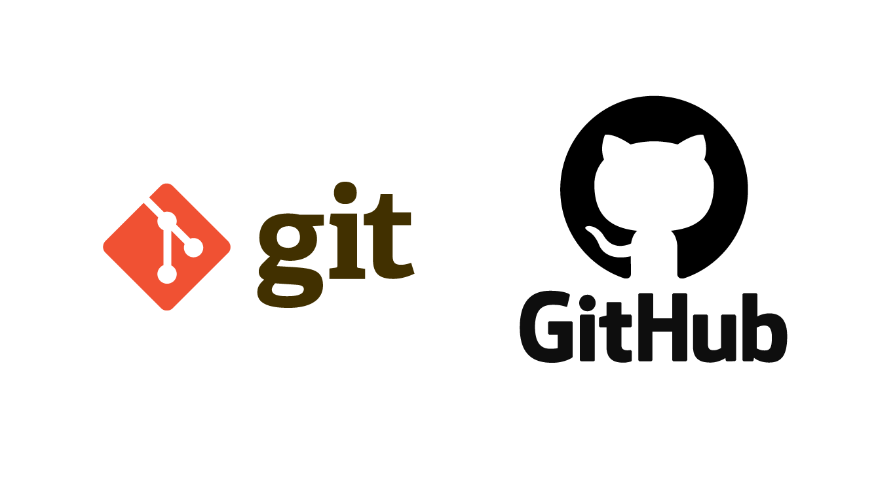

Slide 3
“Find Your Self”
ACCEPT AND
GROW

Slide 4
GIT
What is Git?: A version control system to track changes in your code.
Why use Git?:
Manage different versions of projects,
Collaboration
And Backup.

Slide 5
GIT
Keeping track of every change made to your code.
Seeing who changed what in the project.
Collaborating on code with others easily.

Slide 6
GIT
Stores your project in a central folder called a repository.
Makes a copy of the project on your computer so you can work offline.
Stages and commits changes, allowing you to decide which updates to save.
Branches your project, so you can experiment or add features without messing up the main code.
Merges changes to bring all updates together.
Pulls the newest version of the project from others.
Pushes your updates to share your work with the team.

Slide 7
GIT HUB
An online home for your Git repositories.
Makes collaboration easier by sharing code and reviewing changes.
Shows your project to the world or just your team.

Slide 8
Thanks!

